Slide 1

Component 1
– Upgrade the ICT system –
Belgrade, 5 December 2017

Slide 2
Upgrade the ICT system
Mission of the official statistics
“The basic mission of official statistics means providing of relevant, impartial, reliable, timely and internationally comparable statistical indicators...“

Slide 3
Upgrade the ICT system
Vision and values of the official statistics
“System of official statistics of the Republic of Serbia, by strengthening expert and infrastructural capacities and adopting and applying the best statistical practices should reach the high level of harmonization with international statistical standards, involving the high level of quality of the published statistical data and gained trust of respondents and users.”

Slide 4
Upgrade the ICT system
In order to achieve the goals of our mission and vision, it is necessary to have a reliable and developed ICT system.
With this Project, the implementation of activities within the scope of Component 1, the European Union has greatly contributed to that end.

Slide 5
Upgrade the ICT system
Project goals
  Development of a metadata system – Integration of the system for collection, processing and dissemination of data
  New website – Meet the needs of the statistical products users
  Implementation of the SDMX infrastructure – Introduction of international data exchange standards
  Interoperability – Providing the infrastructure for data exchange and the OpenData platform

Slide 6
Upgrade the ICT system
Why did we want the change
  Meet the needs of the users – results of the users’ satisfaction survey and users’ requests
  Provide adequate web analytics
  Do the review of the current contents
  Keep up with the new technologies – business processes automation and good practice of other NSO

Slide 7
Upgrade the ICT system
– New website –
What did we want to achieve
  Relevance
  Accuracy and reliability
  Timeliness and punctuality
  Coherency and comparability
  Accessibility and clarity

Slide 8
Upgrade the ICT system
– New website –
Structure: A clear system of menus, precise and detailed search, classification – according to statistical topics, simple navigation, user-friendly, intuitive
Design: Transparent home page, modern, transparent, descriptive, “clean” in designer terms (in only a few colours), responsive to all devices (PC, laptop, tablet, mobile phone)
Availability: 1 click

Slide 9
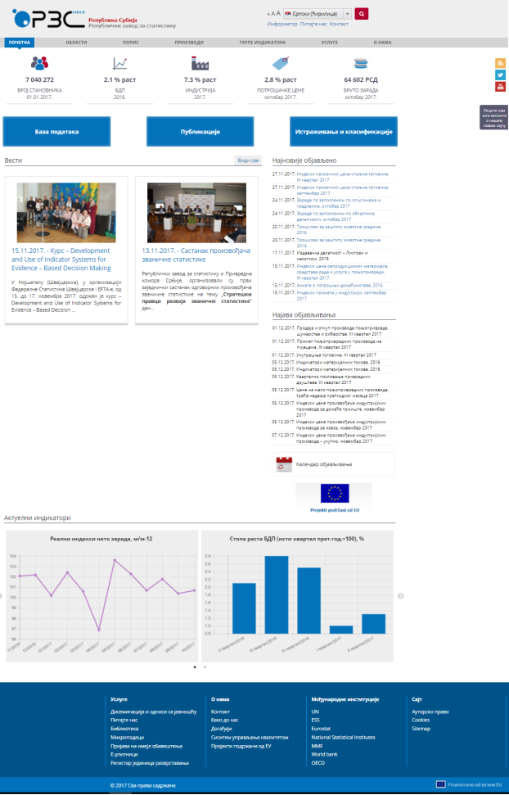

Slide 10
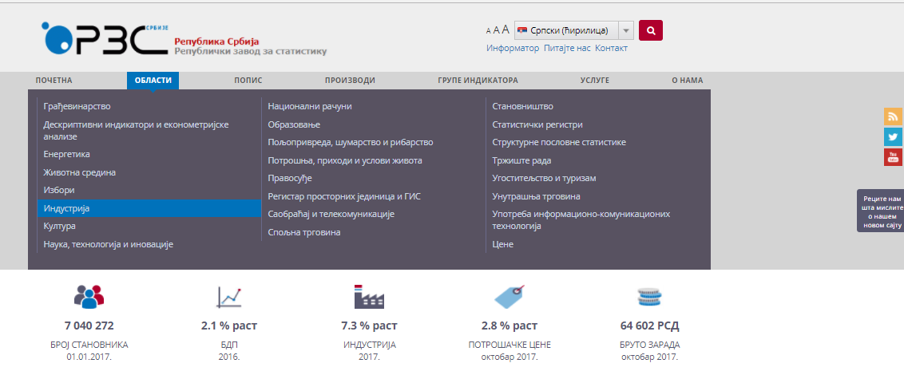

Slide 11
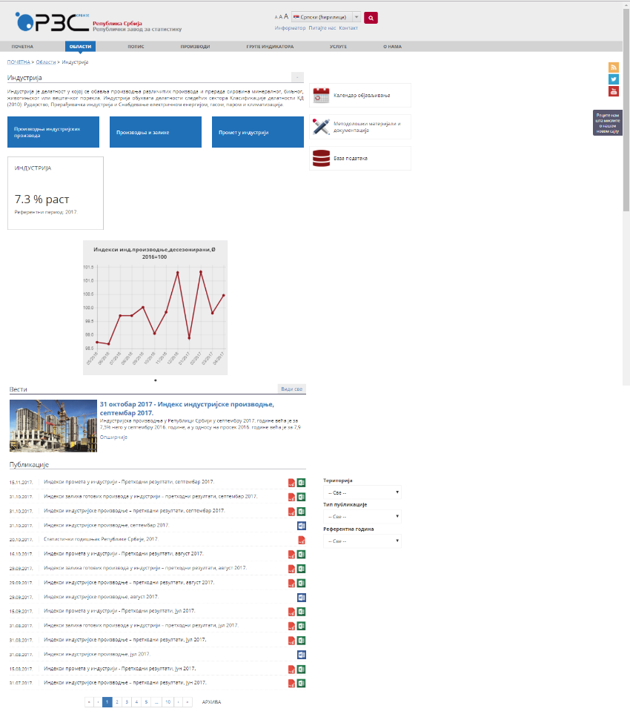

Slide 12
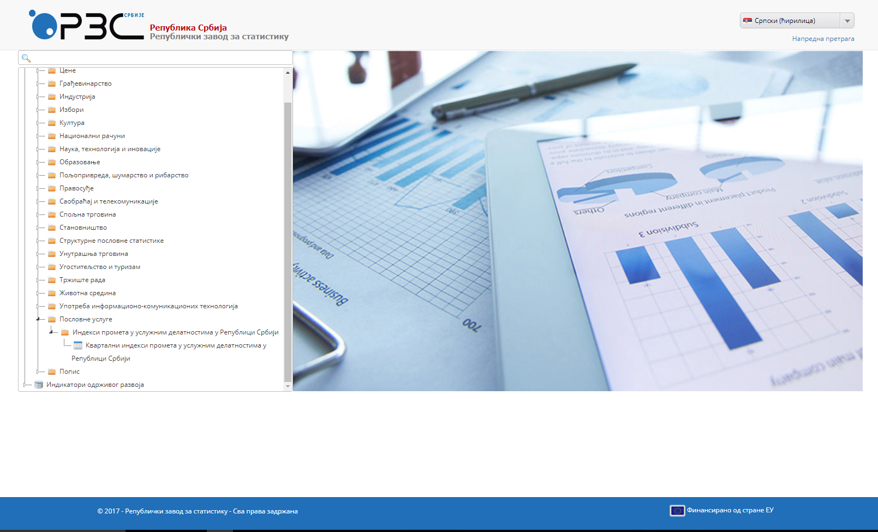

Slide 13
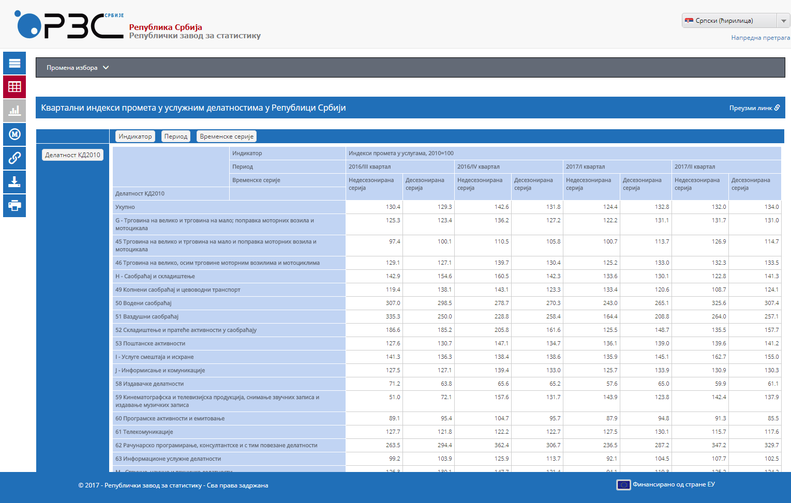

Slide 14
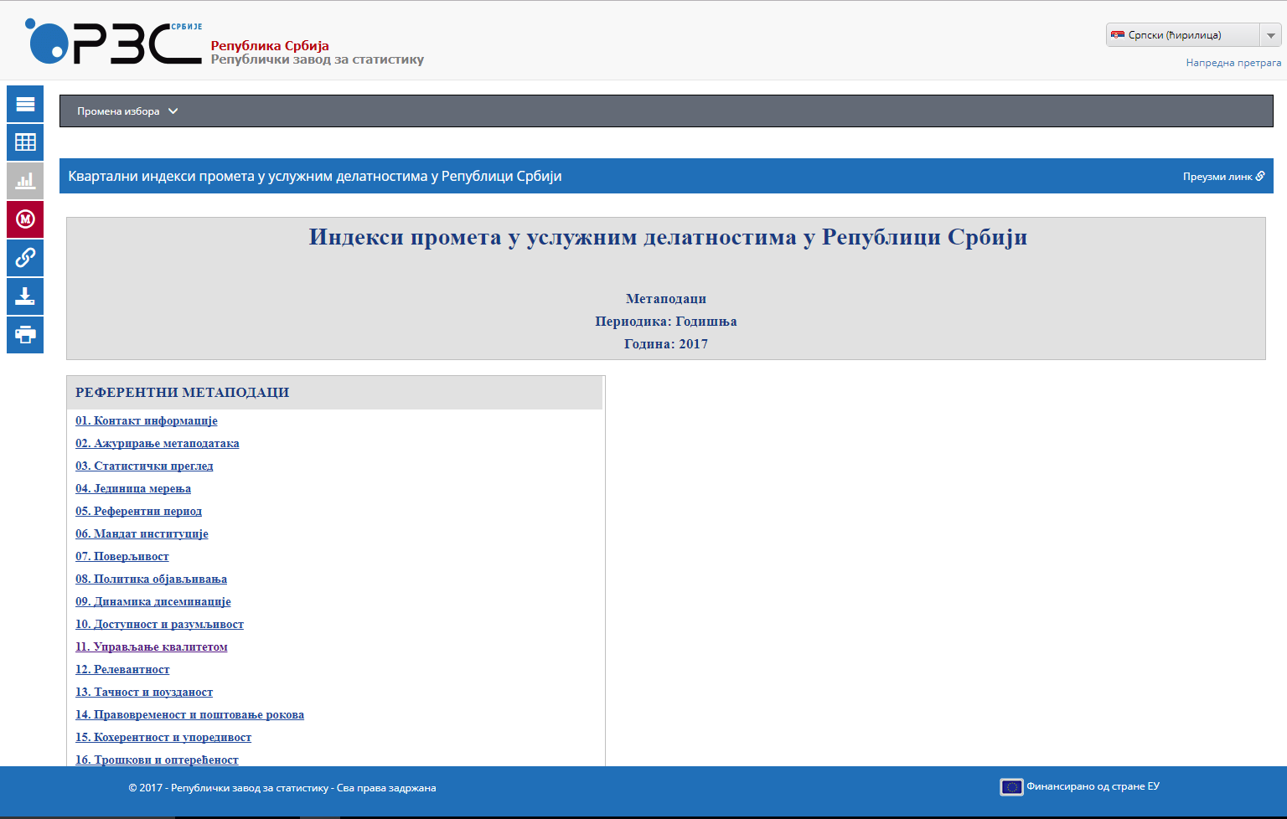

Slide 15
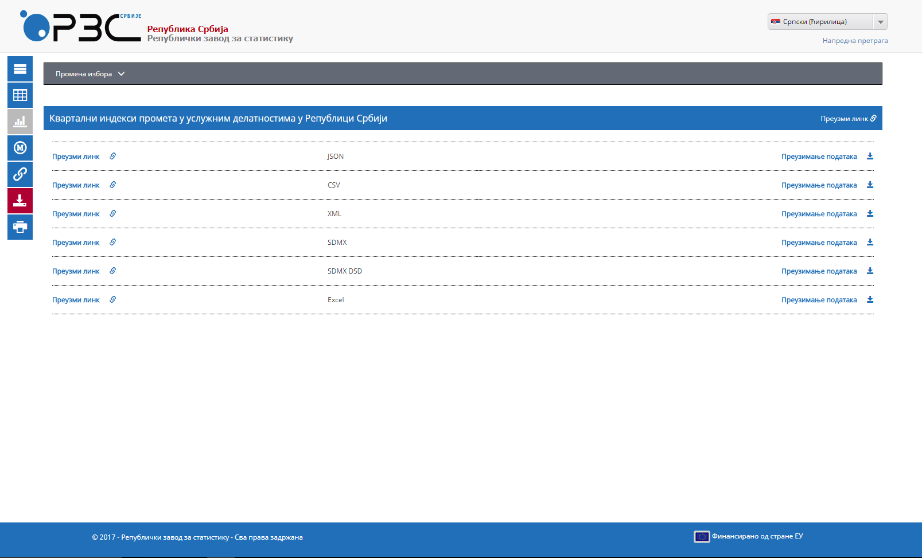

Slide 16
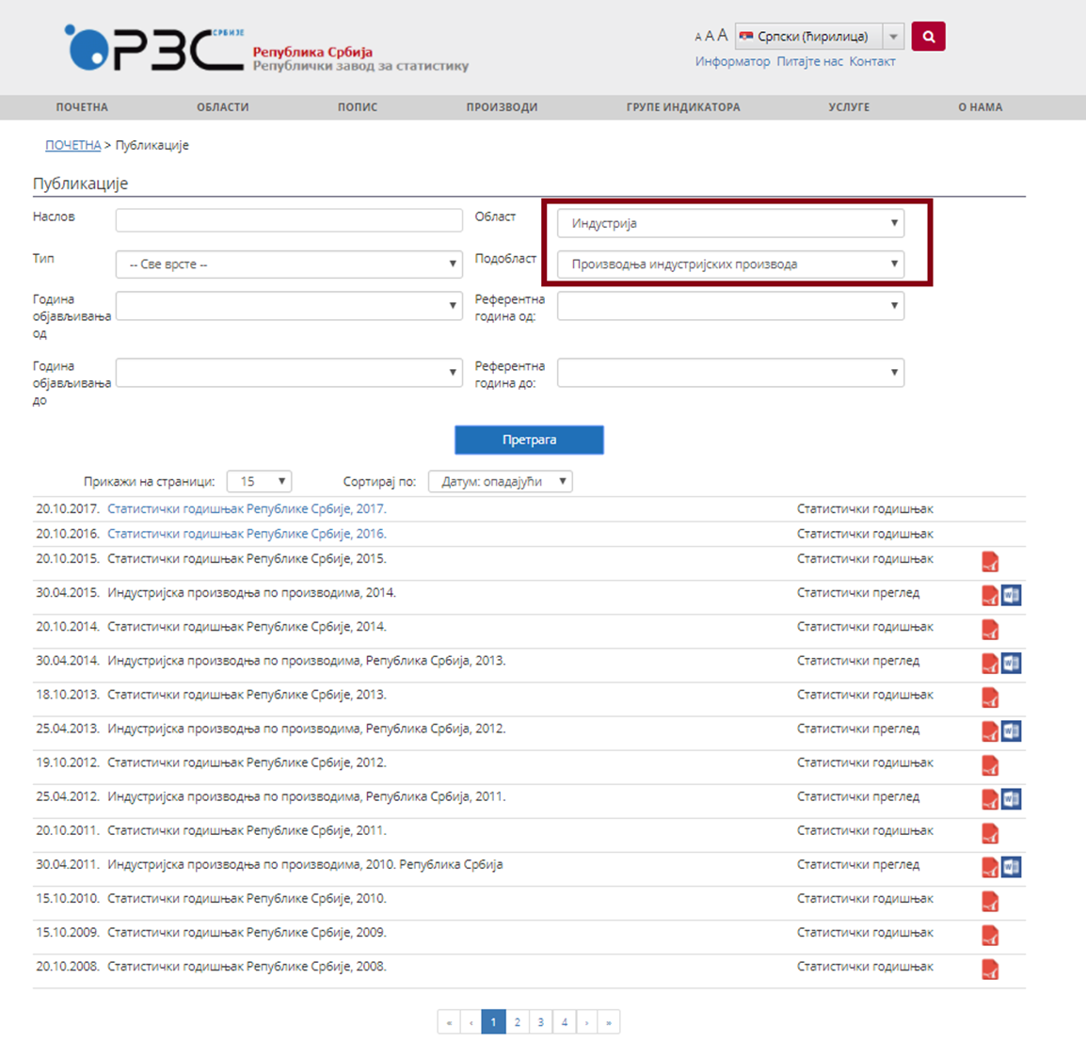

Slide 17
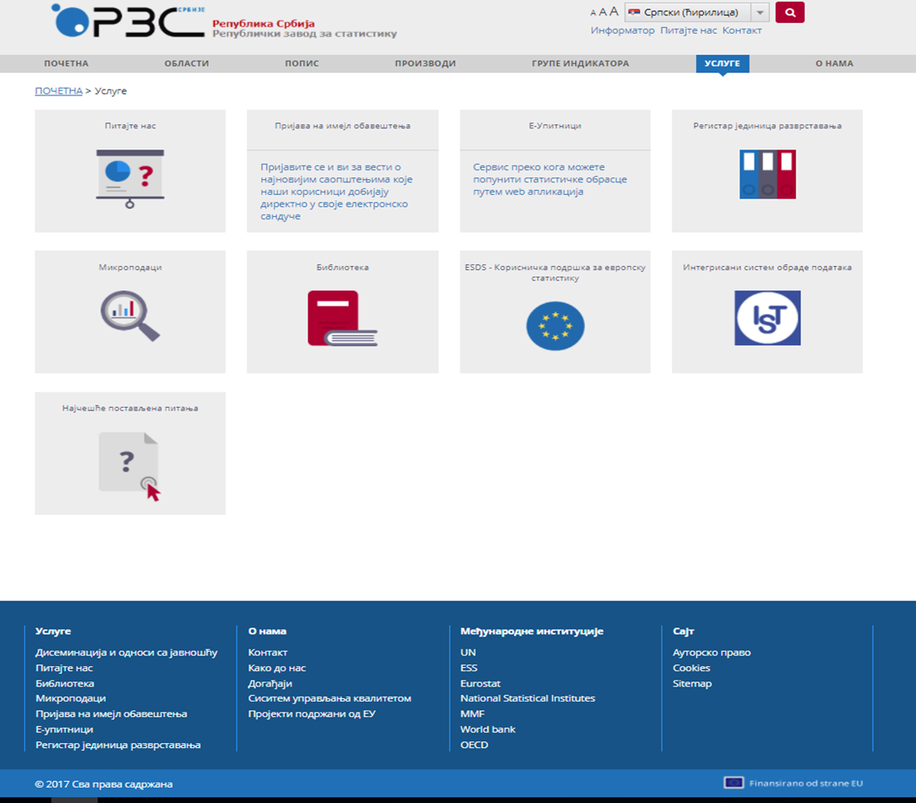

Slide 18
Upgrade the ICT system
– New website –
The beta version of the new website of the Statistical Office of the Republic of Serbia will be officially available to users as of 17 December 2017 at the following address:
http://beta.stat.gov.rs

Slide 19
Thank you for your attention!

