Slide 1
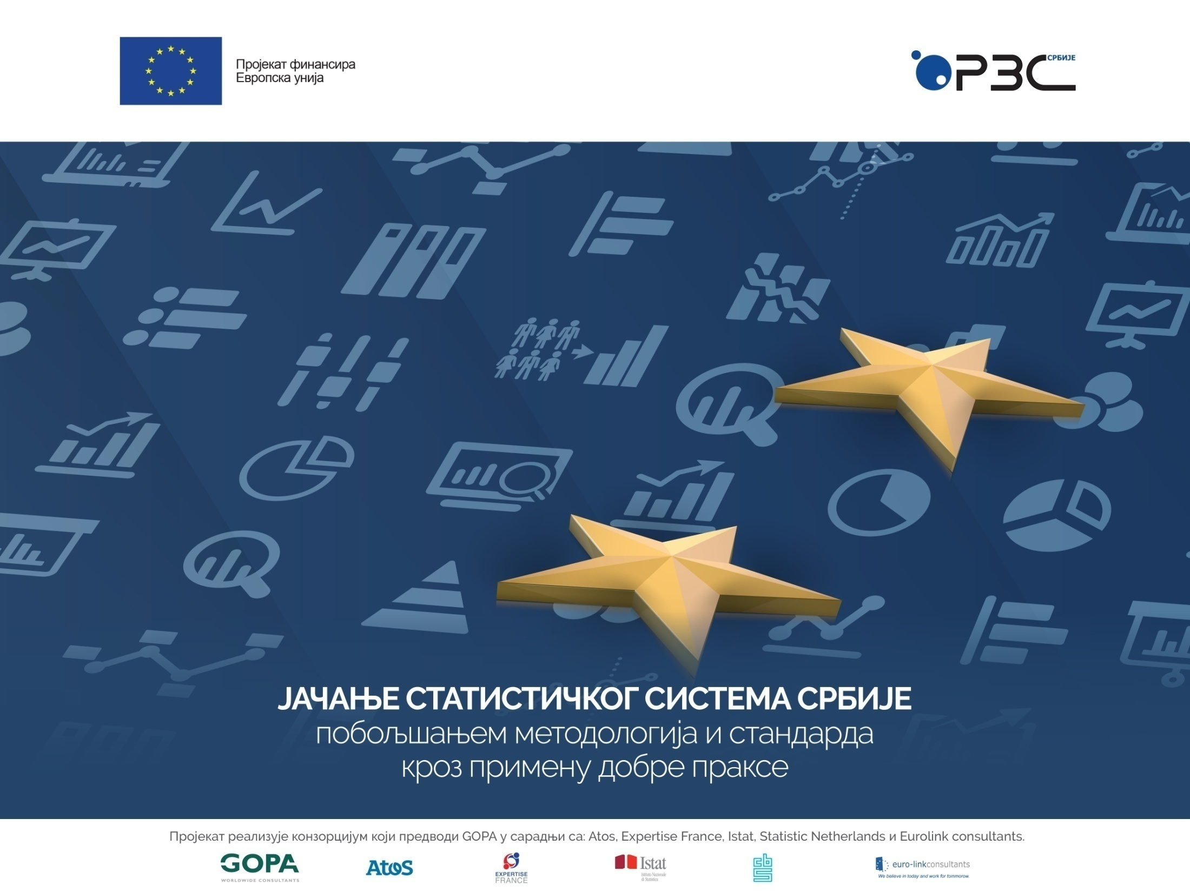
Component 3
Sustainable Development Indicators

Slide 2
Sustainable Development
SOCIAL RESPONSIBILITY
ENVIRONMENTAL PROTECTION
ECONOMIC DEVELOPMENT
“Sustainable development is development that meets the needs of the present without compromising the ability of future generations to meet their own needs.”

Slide 3


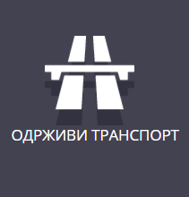
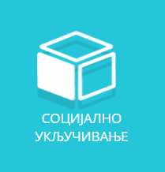
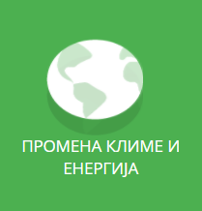
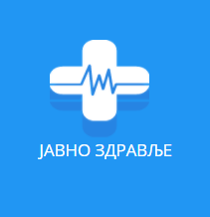
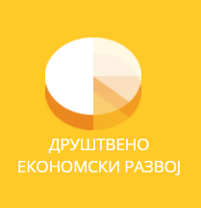
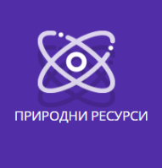


European Union Sustainable Development Strategy
Continuous improvement of the quality of life
Monitoring of strategy implementation - The EU set of Sustainable Development Indicators (SDI)
135 indicators
New tendencies: Different sets of indicators used for monitoring different strategies

Slide 4


Sustainable Development Indicators
EU-SDI
Sustainable Development Goals SDG

Slide 5

Component 3: Development of a set of Sustainable Development Indicators (SDI)
SORS – coordination role, as well as a production of a number of indicators
In addition to the SORS, other institutions that are a part of the statistical system of Serbia have also been responsible for the production of indicators
New dimension of cooperation

Slide 6

Activities through the Project
Indicator mapping and inventory
Gap analysis
Recommendations
Indicator calculation
Metadata
Web portal
Study visits and workshops
Availability of indicators:
In the beginning 39% → 77% in the end

Slide 7
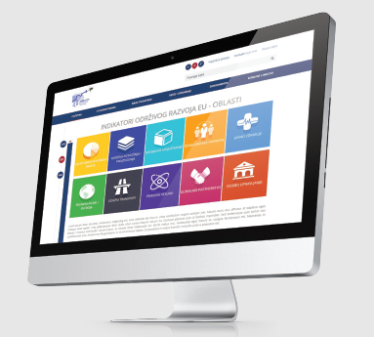
The results – more than planned
Gained knowledge and experience that will be of great use in the future for monitoring other strategies (SDG in the near future)
The tools have been developed in such a way that they may be used for other purposes as well
An information system has been developed that can become
NATIONAL PORTAL FOR THE MONITORING OF INDICATORS.
SDG
SDI

Slide 8
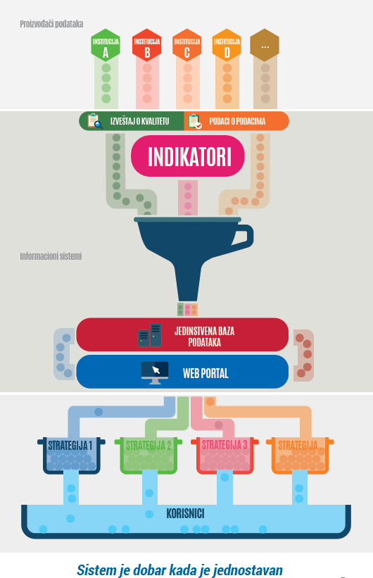
Information system
Vision – to bring together in one place all indicators for the monitoring of different national and international strategies
The “One-stop-shop” principle
Both the users and the producers of data will have benefit from such a system
The “funnel” system – a unique dissemination database which contains indicators, quality reports and metadata, which are then published in one place – the National portal.

Slide 9
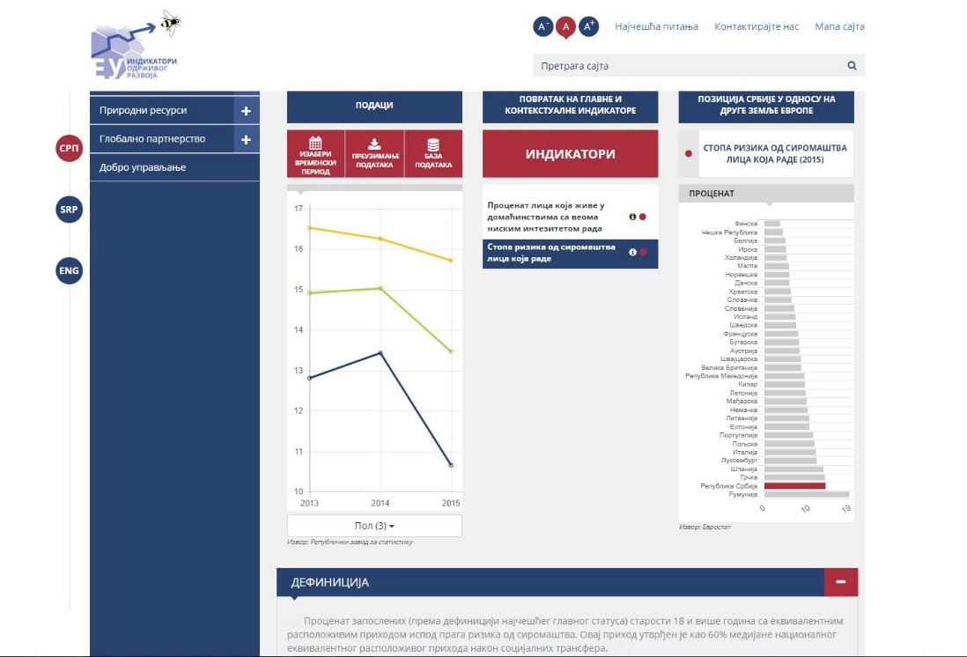
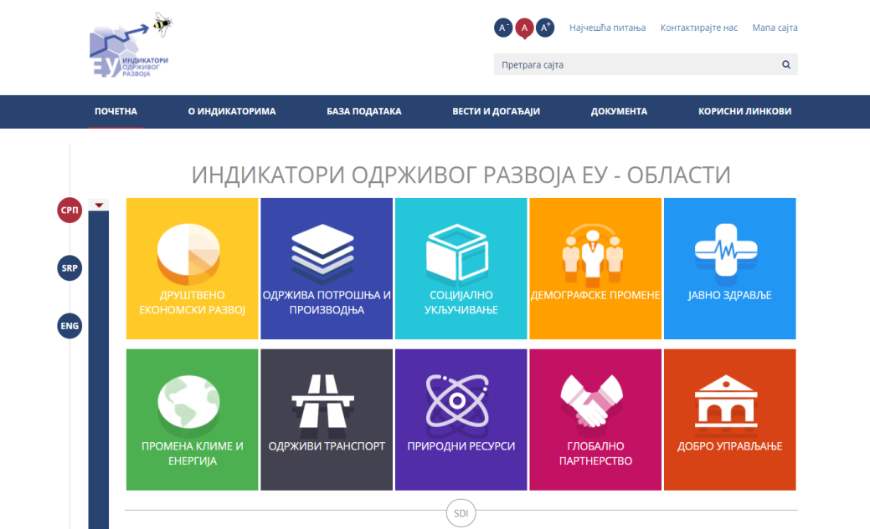
National portal for the monitoring of indicators
After selecting an appropriate strategy, the users at the portal have access to graphs and numerical presentations, definitions (of topics and indicators), basic disaggregations of data, with a possibility to have a direct access to the dissemination database where users have available all existing disaggregations of data, metadata and quality reports.
www.indikatori.rs

Slide 10

Vision for the future
The developed information system, i.e., the National portal for the monitoring of indicators, is a common resource of all producers of (official) statistics, although it has been developed by SORS
Further development and enhancement of the portal in line with the future needs
Automation as much as possible in order to increase efficiency of all producers of (official) statistics
The portal currently provides data for the EU SDI set (the process of feeding data is still ongoing), but we hope that the portal will soon be used for other national and international strategies (SDG, SEE 2020, etc.)

Slide 11
Preconditions for the vision implementation (3C)
Communication
Cooperation
Coordination

Slide 12
Thank you for your attention!
Nevena Pavlović
nevena.pavlovic@stat.gov.rs
Sustainable Development Indicators and SILC group
Social statistics department
Statistical Office of the Republic of Serbia

